Slide 1
English
Unit 2 – Sport
Thursday 17th September 2026
WALT:
6Lm.01 – Understand, with support, most of the main points of short and extended talk.

Slide 2



WALT: Understand, with support, most of the main points of short and extended talk.
I can identify sports from an audio recording.
I can answer true or false questions about an audio recording.
I can discuss the reasons the children in the audio recording had for liking sports.

Slide 3

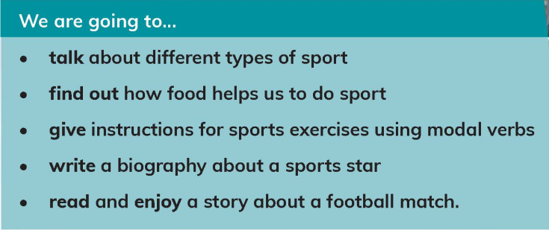
Starter
WALT: Understand, with support, most of the main points of short and extended talk.
Which part of this unit are you looking forward to the most?
Which do you think might be the most challenging?

Slide 4
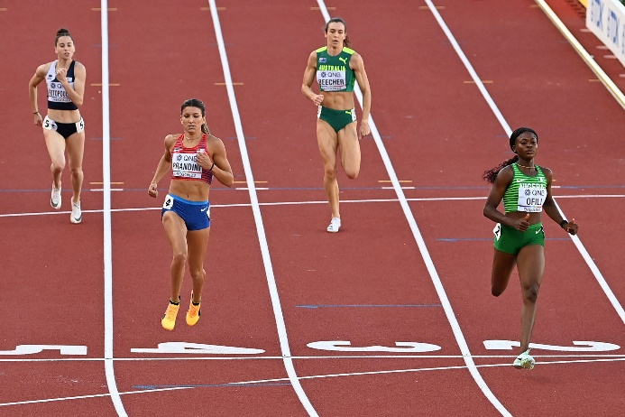
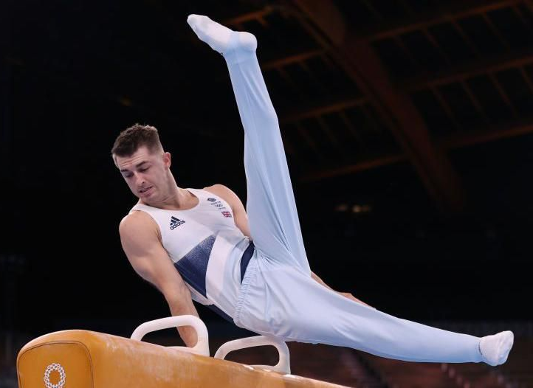
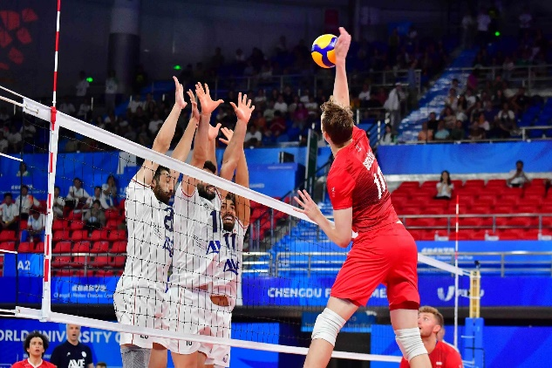
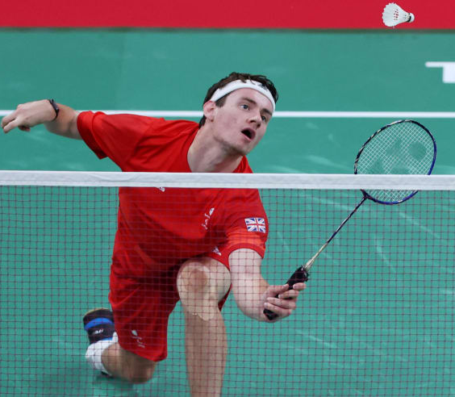
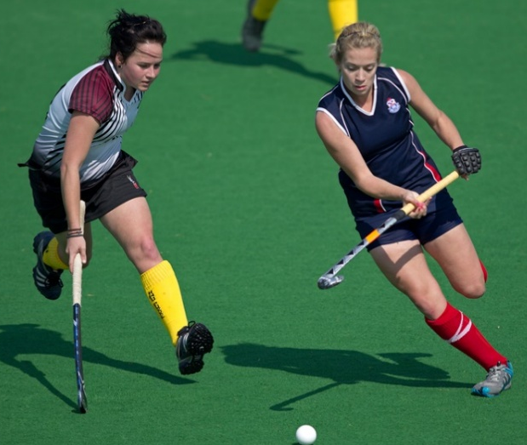
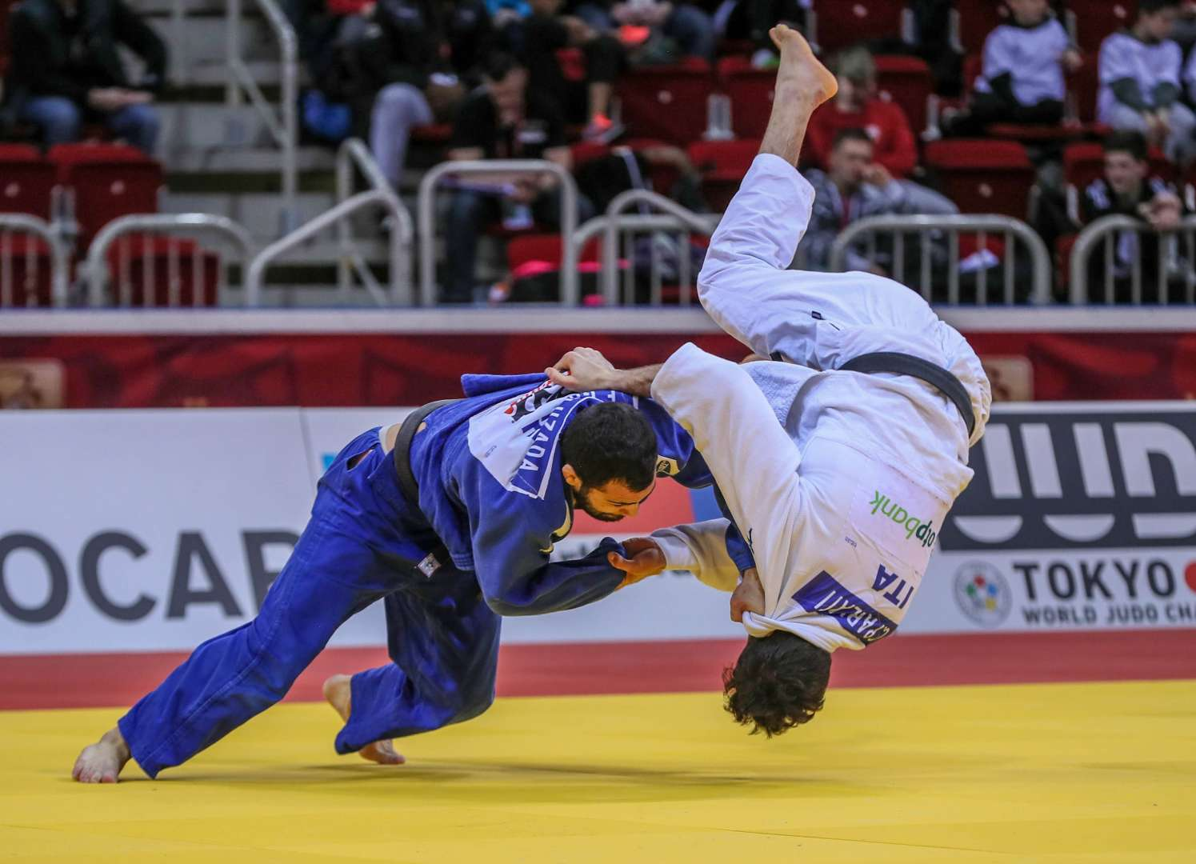
Can you name the sports in the pictures?
WALT: Understand, with support, most of the main points of short and extended talk.
Have you ever done any of these sports?
volleyball
gymnastics
athletics
badminton
Which sports do you do?
hockey
judo

Slide 5
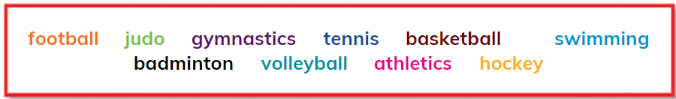

WALT: Understand, with support, most of the main points of short and extended talk.
Listen to the children talking about sport.
Which sports from the list above are they talking about?

Slide 6
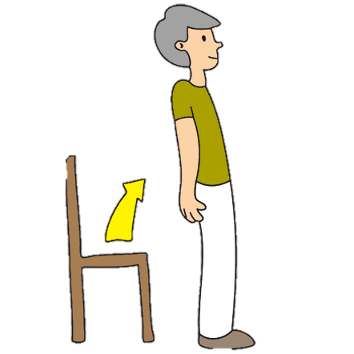

WALT: Understand, with support, most of the main points of short and extended talk.
If you think the statement is TRUE stand up.
If you think the statement is FALSE put your hands on your head.

Slide 7
WALT: Understand, with support, most of the main points of short and extended talk.
If you think the statement is TRUE stand up.
If you think the statement is FALSE put your hands on your head.

Slide 8
WALT: Understand, with support, most of the main points of short and extended talk.
If you think the statement is TRUE stand up.
If you think the statement is FALSE put your hands on your head.

Slide 9
WALT: Understand, with support, most of the main points of short and extended talk.
If you think the statement is TRUE stand up.
If you think the statement is FALSE put your hands on your head.

Slide 10
Discuss with your partner – What other reasons did the children have for liking their sports?
WALT: Understand, with support, most of the main points of short and extended talk.

Slide 11
WALT: Understand, with support, most of the main points of short and extended talk.
I can identify sports from an audio recording.
I can answer true or false questions about an audio recording.
I can discuss the reasons the children in the audio recording had for liking sports.

Slide 12
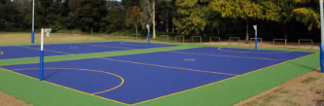


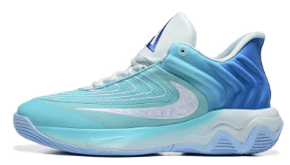
Plenary – What’s your favourite sport?
WALT: Understand, with support, most of the main points of short and extended talk.
What equipment do you need to practice it?

